Slide 1
CS118 – Programming Fundamentals
Lecture # 25
Monday, November 25, 2019
FALL 2019
FAST – NUCES, Faisalabad Campus
Course Instructor:
Ebad Majeed
Slides Credit:
Rizwan Ul Haq

Slide 2
Quiz: 04
What is the difference b/w bubble sort and selection sort?
Q. Write a program to print multiple of all the columns of a 2d array one by one and at the end print multiple of whole array.
Assumption array size is 5x5.

Slide 3
Multidimensional Arrays
Multidimensional array: collection of a fixed number of elements (called components) arranged in n dimensions (n >= 1)
Also called an n-dimensional array
Declaration syntax:
To access a component:

Slide 4
Example
For example
double carDealers[10][5][5];
The base address of the array carDealers is the address of the first array component—that is, the address of carDealers[0][0][0]
The total number of components in the array carDealers is 10 * 5 * 5 = 250
carDealer[5][3][2] = 15009.65; // sets the value of carDealer[5][3][2] to 15009.65
for(int i=0 ; i<10 ; i++)
for(int j=0 ; j<5 ; j++)
for(int k=0 ; k<5 ; k++)
carDealer[i][j][k] = 0.0 ;
Initialize all of the elements in array to 0.0

Slide 5
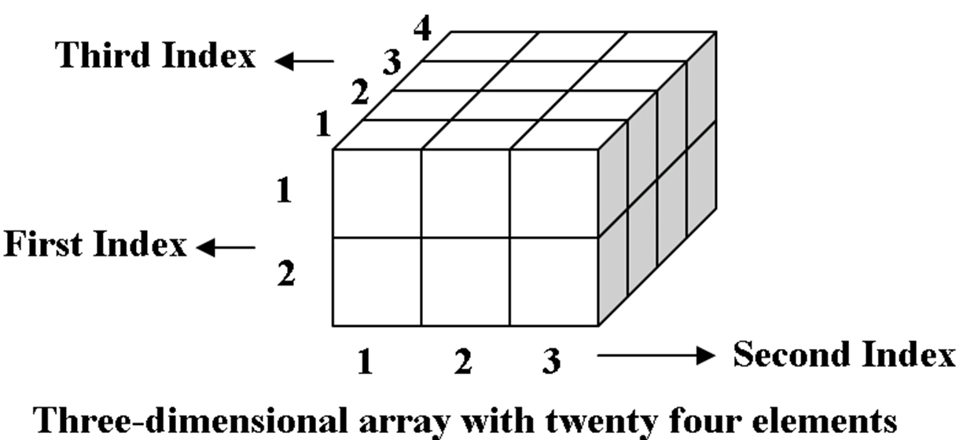
Example

Slide 6
Multidimensional Arrays (cont'd.)
When declaring a multidimensional array as a formal parameter in a function
Can omit size of first dimension but not other dimensions
As parameters, multidimensional arrays are passed by reference only
A function cannot return a value of the type array
There is no check if the array indices are within bounds

Slide 7
String Datatype
Basic Functions

Slide 8
The string Type
To use the data type string, the program must include the header file string
#include <string>
The statement
string name = "William Jacob";
declares name to be string variable and also initializes name to "William Jacob".
The position of the first character, 'W', in name is 0, the position of the second character, 'i', is 1, and so on
The variable name is capable of storing (just about) any size string

Slide 9
String basic functions
Binary operator + (to allow the string concatenation operation), and the array index (subscript) operator [], have been defined for the data type string
Suppose we have the following declarations
string str1, str2, str3;
The statement
str1 = "Hello There“ ;
stores the string "Hello There" in str1.
The statement
str2 = str1;
copies the value of str1 into str2.

Slide 10
String basic functions
If str1 = "Sunny", the statement
str2 = str1 + " Day";
stores the string "Sunny Day" into str2.
If str1 = "Hello“ and str2 = "There“ then
str3 = str1 + " " + str2;
stores "Hello There" into str3
This statement is equivalent to the statement
str3 = str1 + ' ' + str2;

Slide 11
String basic functions
The statement
str1 = str1 + "Mickey“ ;
updates the value of str1 by appending the string "Mickey" to its old value
If str1 = "Hello there", the statement
str1[6] = 'T‘ ;
replaces the character t with the character T.

Slide 12
The length Function
The length function returns the number of characters currently in the string
The value returned is an unsigned integer
The syntax to call the length function is:
strVar.length()
where strVar is variable of the type string
The function length has no arguments

Slide 13
String datatype
Consider the following statements:
string firstName ;
string name ;
string str ;
firstName = “Elizabeth";
name = firstName + " Taylor";
str = "It is sunny outside.";
Statement Effect
cout<<firstName.length()<<endl; Outputs 9
cout<<name.length()<<endl; Outputs 16
cout<<str.length()<<endl; Outputs 20

Slide 14
The size Function
The function size is same as the function length
Both these functions return the same value
The syntax to call the function size is:
strVar.size()
where strVar is variable of the type string.
As in the case of the function length, the function size has no arguments

Slide 15
The find Function
The find function searches a string to find the first occurrence of a particular substring and returns an unsigned integer value (of type string::size_type) giving the result of the search
The syntax to call the function find is:
strVar.find(strExp)
Where strVar is a string variable and strExp is a string expression evaluating to a string
The string expression, strExp, can also be a character
If the search is successful, the function find returns the position in strVar where the match begins
For the search to be successful, the match must be exact
If the search is unsuccessful, the function returns the special value string::npos (“not a position within the string”).

Slide 16
String datatype
The following are valid calls to the function find
str1.find(str2)
str1.find("the")
str1.find('a')
str1.find(str2+"xyz")
str1.find(str2+'b')

Slide 17
String datatype
string sentence;
string str;
string::size_type position;
sentence = "It is cloudy and warm.";
str = "cloudy";
Statement Effect
cout<<sentence.find("is")<<endl; Outputs 3
cout<<sentence.find("and")<<endl; Outputs 13
cout<<sentence.find('s')<<endl; Outputs 4
cout<<sentence.find(str)<<endl; Outputs 6
cout<<sentence.find("the")<<endl; Outputs the value of string::nops
position = sentence.find("warm"); Assigns 17 to position

Slide 18
The substr Function
The substr function returns a particular substring of a string
The syntax to call the function substr is:
strVar.substr(expr1,expr2)
where expr1 and expr2 are expressions evaluating to unsigned integers.
The expression expr1 specifies a position within the string (starting position of the substring). The expression expr2 specifies the length of the substring to be returned.

Slide 19
string sentence;
string str;
sentence = "It is cloudy and warm.";
Statement Effect
cout<<sentence.substr(0,5) << endl ; Outputs: It is
cout<<sentence.substr(6,6) << endl ; Outputs: cloudy
cout<<sentence.substr(6,16) << endl ; Outputs: cloudy and warm.
cout<<sentence.substr(3,6) << endl ; Outputs: is clo
str = sentence.substr(0,8); str = "It is cl"
str = sentence.substr(2,10); str = " is cloudy"

Slide 20
The Function swap
The function swap is used to swap—that is, interchange—the contents of two string variables
The syntax to use the function swap is
strVar1.swap(strVar2);
where strVar1 and strVar2 are string variables.
Suppose you have the following statements:
string str1 = "Warm";
string str2 = "Cold";
After the following statement executes, the value of str1 is "Cold" and the value of str2 is "Warm".
str1.swap(str2);

Slide 21
Questions

